Slide 1


SNC8x series professional audio processor
Shenzhen Soundec Technology
深圳市九音科技有限公司

Slide 2

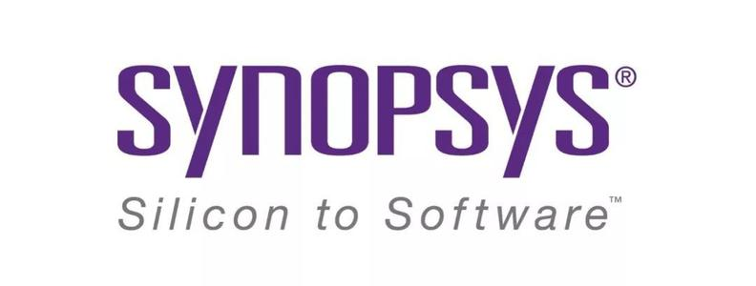


Company Profile
Focus on acoustic research and commercialization
Shenzhen Soundec Technology Co., Ltd. (“Soundec Technology ”) is a high-tech enterprise focusing on acoustic research and commercialization. Founded in 2017, we seek to consistently deliver excellent solutions in the areas of audio.
Building upon our core competence in audio processing technology, Soundec Technology provides a series of professional audio processors integrating AI algorithms, high-quality codecs, high-performance DSP, high-speed USB and power management units. Support in-depth development and turn-key solutions for algorithm + chip + application design.
Cooperation with the top semiconductor IP partners and chip manufacturers, Soundec Technology is committed to creating a serials of world-class audio processors and solutions, providing customers with reliable quality, stable supply and professional service acoustic solutions.

Slide 3
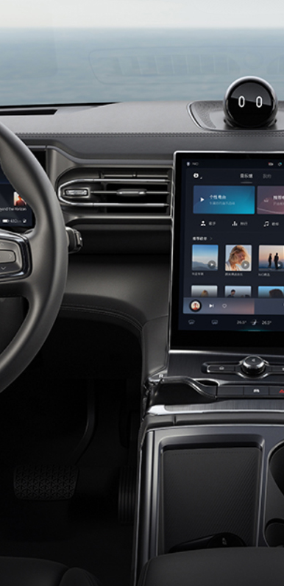
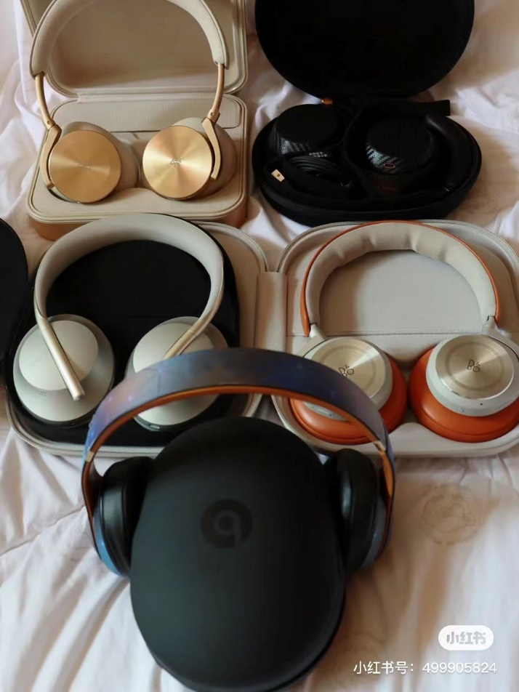
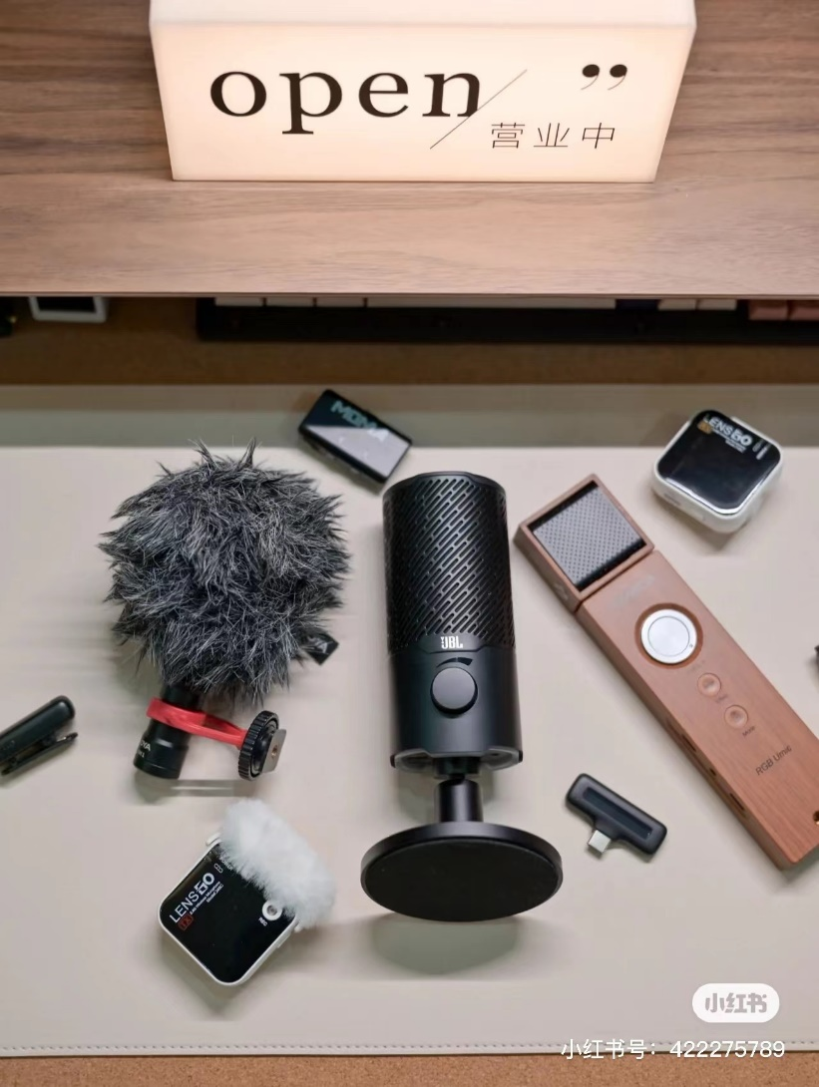
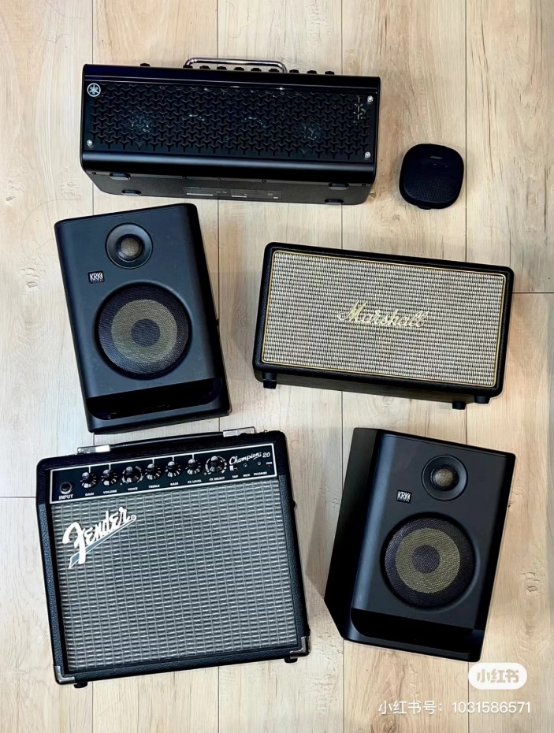
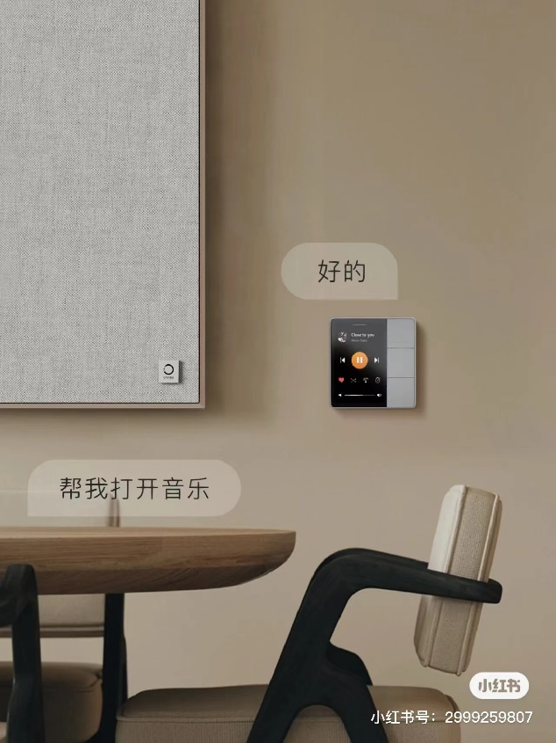
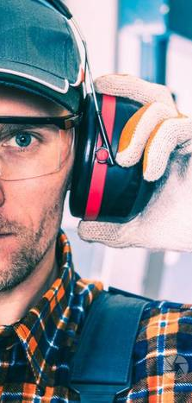
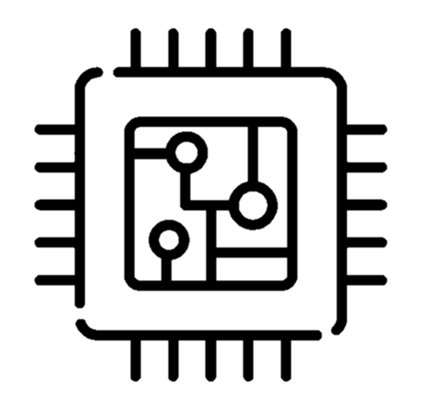
Deep into the professional audio market
Soundec Professional audio processor
Automotive electronics
Headset
Microphone
Speakers
AIoT
Industrial
noise reduction
Terminals with interaction and control requirements will have audio entry, increasing the requirements for sound quality and personalized perception. Soundec series chips deeply service for the professional pre/post-processing market

Slide 4

Contents
32Bit high performance audio signal processor
HiFi3 Architecture
Cooperation ecosystem
SDK Platform
Modules BMT02/BMT03/BMT03-MicArray
Packaging & Electrical performance
Developer ecosystem
Documents supporting

Slide 5
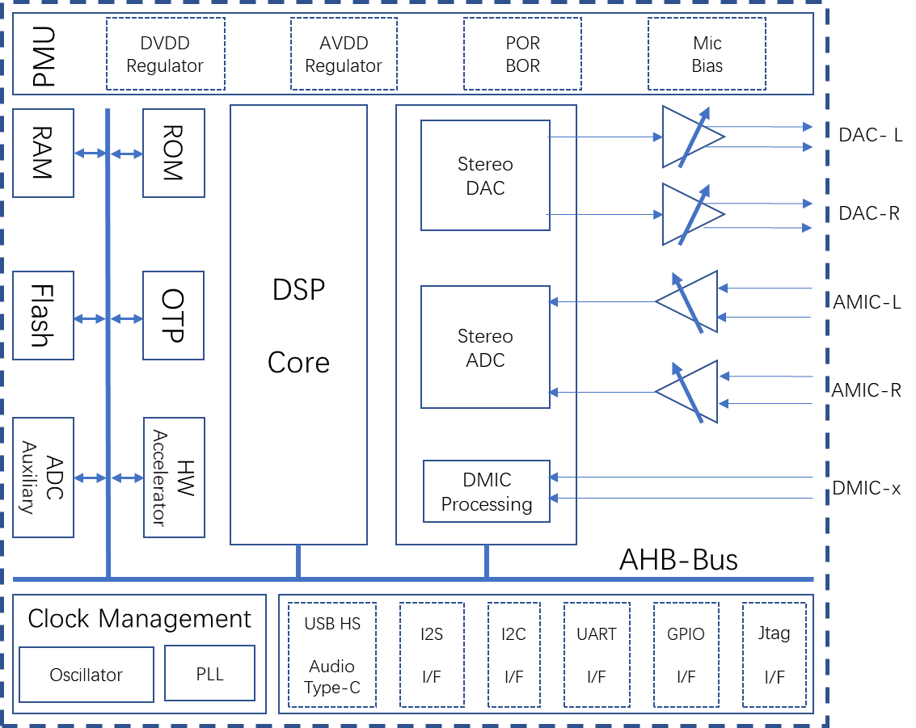
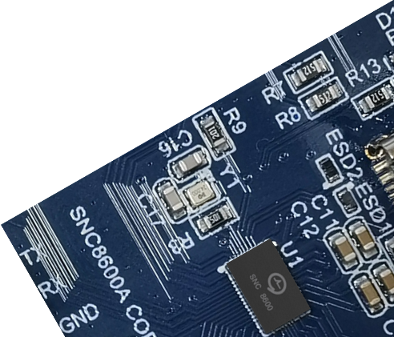
32Bit high performance audio signal processor
SNC8x series audio signal processor, integrated AI algorithm and high quality Codec, high performance DSP, USB2.0 HS device and power management unit.
High integration of SoC greatly reduces BOM cost and development cycle.
Rich developer ecosystem.
Key Features
Cadence Tensilica™ 32-bit HiFi3 DSP @200MHz
32-bit floating point unit, hardware acceleration
Build-in AGC、DRC、Mixer、Wind Noise filter
Build-in LDO and DC-DC power manager
24-bit high precision ADC, SNR>=106dB, sampling rate up to 192kHz
24-bit high precision DAC, SNR>=110dB, sampling rate up to 192kHz
USB2.0 HS/FS device, compliant with UAC Rev1.0 and Rev2.0
Three full duplex I²S interface, sampling rate up to 192kHz
Up to 10 DMIC inputs/2 AMIC inputs
12-bit precision SAR ADC
Full duplex UART
Two I²C interface

Slide 6
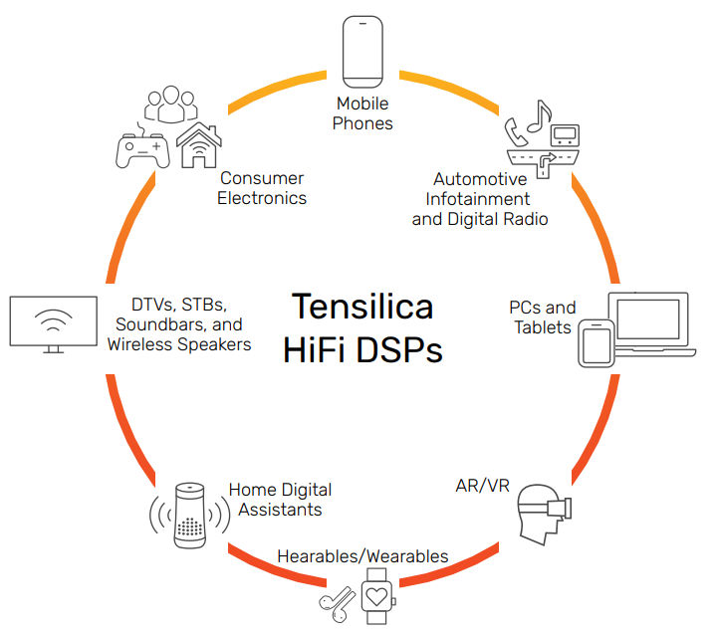

HiFi3 Architecture
Tensilica HiFi DSP
Tensilica HiFi DSP series is the most licensed audio/sound/speech processor
With support for over 300 proven software packages.
More than 125 software partners in the Tensilica Xtensions™ partner program
More than 100 top-tier semiconductor companies and system OEMs have selected Tensilica HiFi DSPs for their audio, voice and speech products
HiFi3 Architecture
HiFi 3 is a VLIW architecture, supporting the execution of three operations in parallel.
Goes beyond the two MAC, four multipliers, three VLIW slots
Good support for 32x16-bit and 32x32-bit multiplication
A true 64-bit data path and native support for ITU-T/ETSI intrinsics.
An optional floating point unit available, providing for a 2-way SIMD, single-precision IEEE floating point MAC or ALU operation every cycle
HiFi3 DSP library
The HiFi3 DSP has an associated generic DSP library, which contains functions for FIR filters, IIR filters, basic math functions, matrix operations, and FFTs.

Slide 7
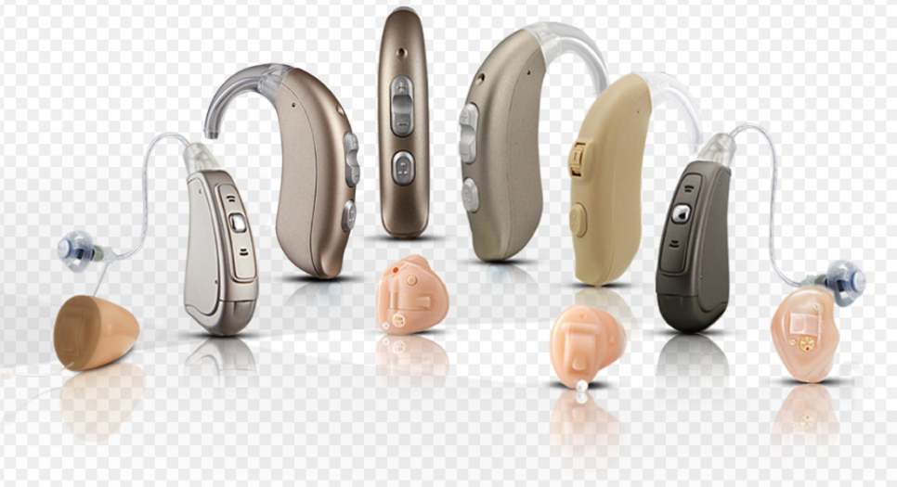
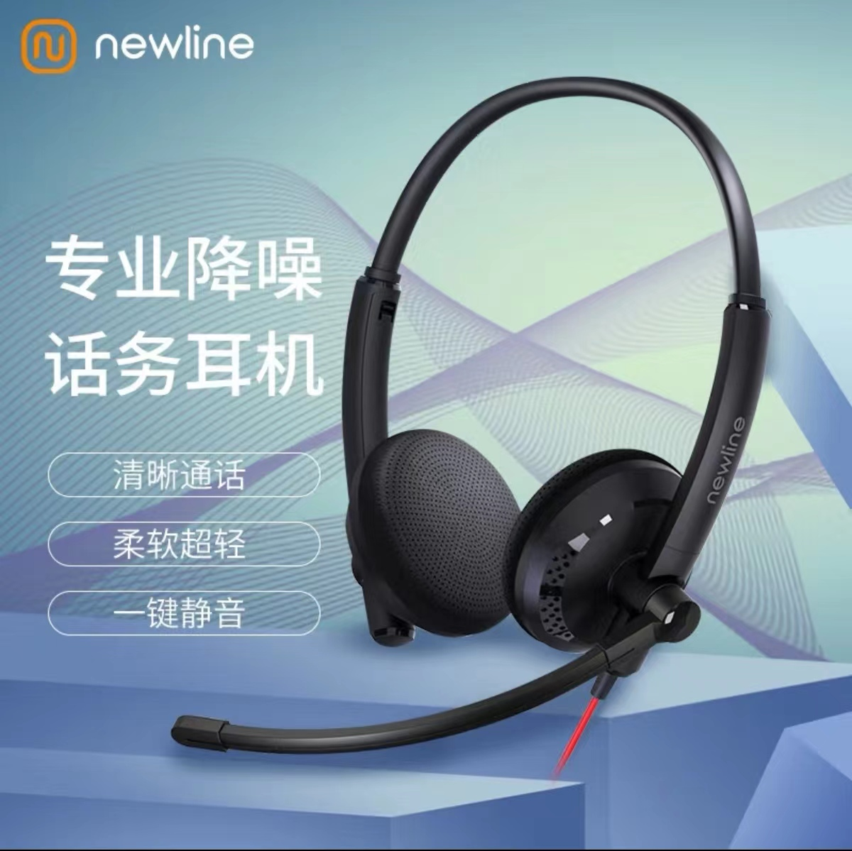
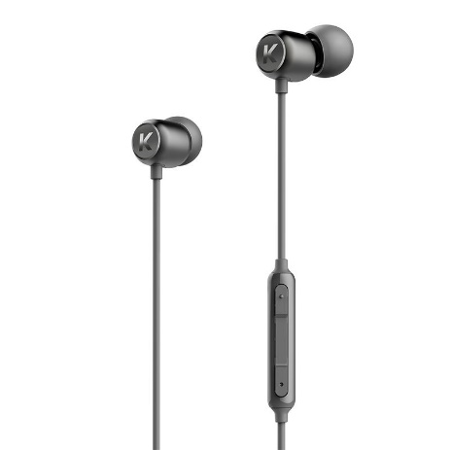
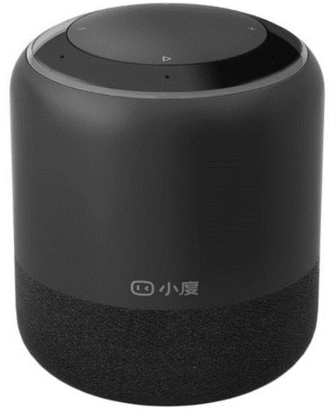
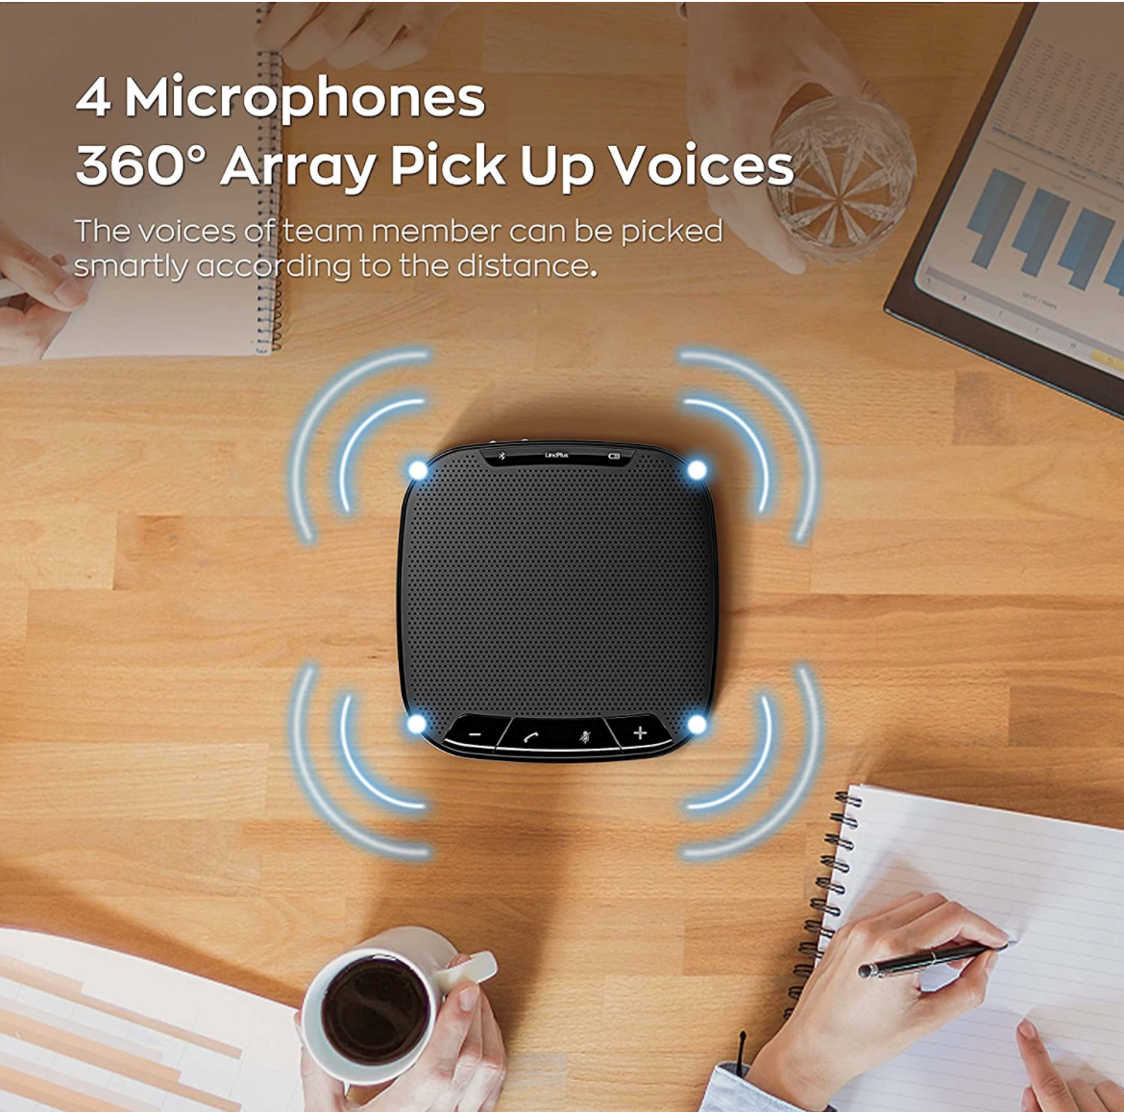
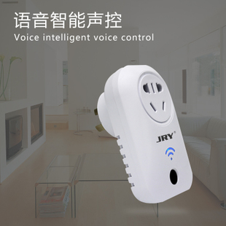
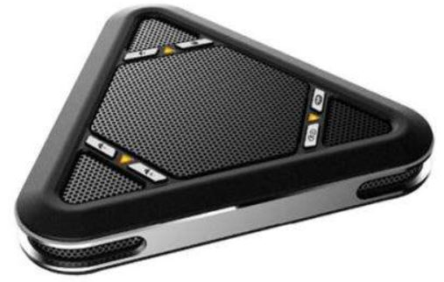
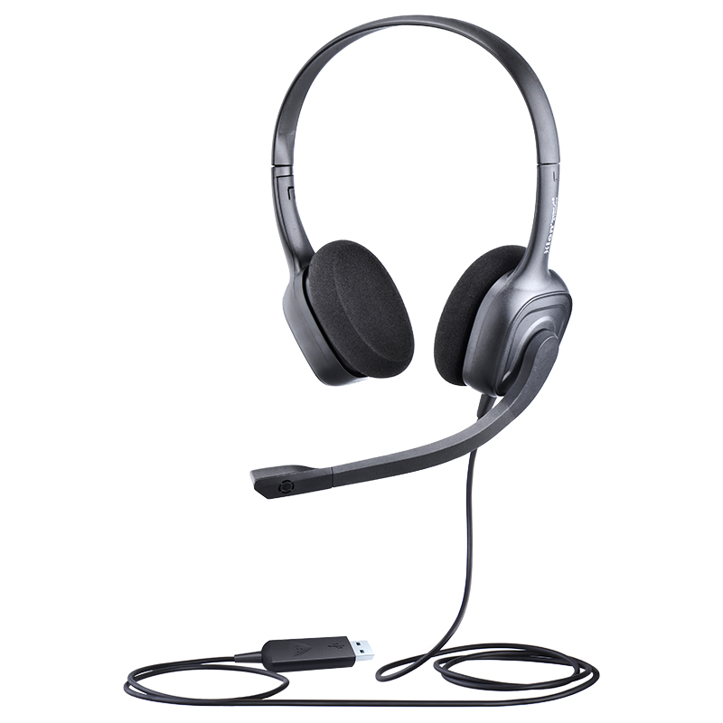
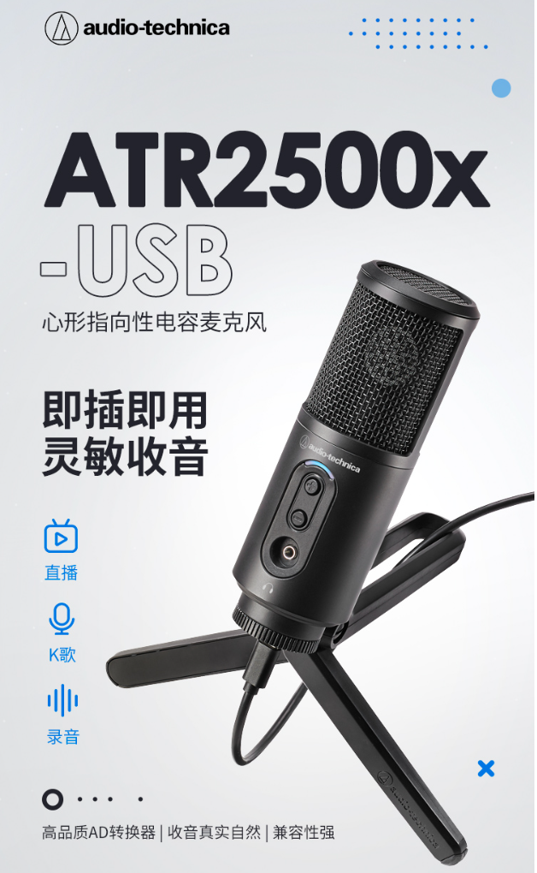
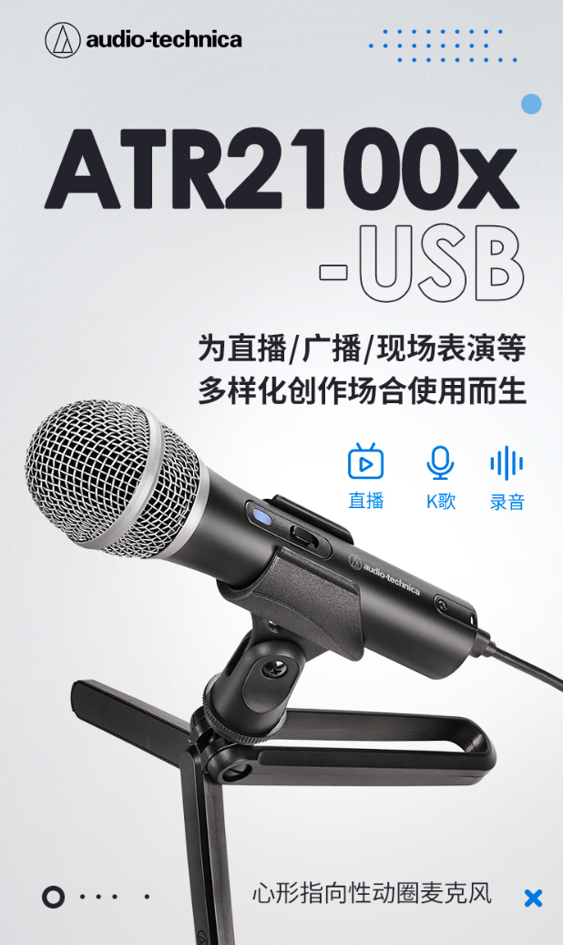
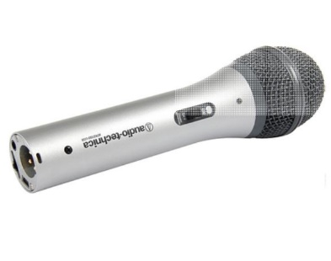
Cooperation ecosystem
Rely on the SDK open platform of SNC86x series to open up the product market with excellent partners.
九音科技
Soundec
SDK Platform
Algorithm
算法公司
Partner
Partner
Brand
终端品牌
Partner
Trader
代理商
Partner
IDH
方案商

Slide 8
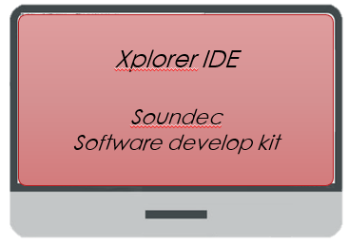
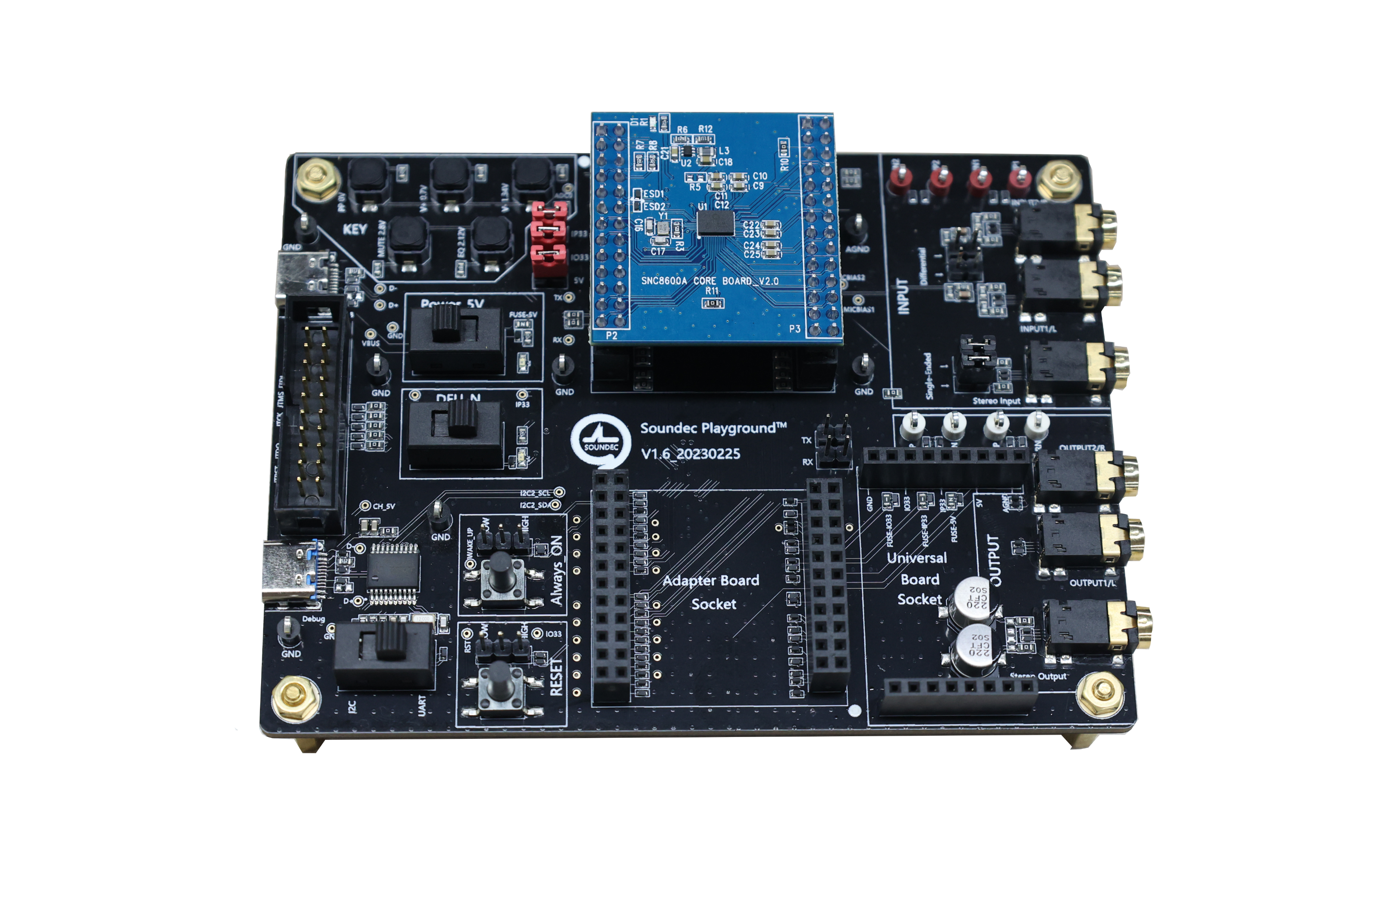

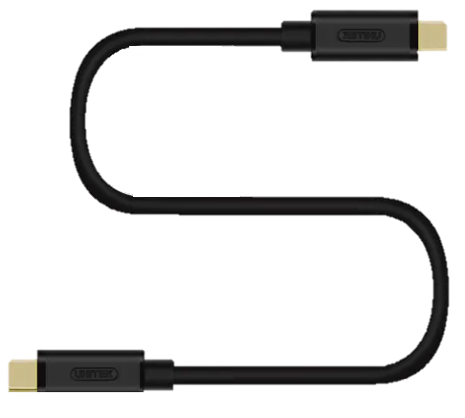
SDK Platform
Software Develop Kit
USB Connection
EVA Board
EVA board with full functions is provided for online debugging and sound settings
Support lotus head, 3.5mm, USB Type-C, USB Mini interface, developers can directly connect the instrument test
Through Adapter Socket， support to adapt different modules, quickly expand the application scheme.
Xtensa Xplorer
九音科技 Soundec
Software develop kit
(crypto for binary code)
Connect EVA board and PC via USB cable for debugging and code upgrade
Topic： Main Clock frequency： SDK version： |  | System efficiency 220MHz SDK20_V1.0 |  |  |  | [Note] Under USB mode，Sampling accuracy is 24Bit
Sampling Rate | Audio Path（SDK free dRAM>=217KB）
 | ADC->DAC |  | I2S->DAC | I2S->I2S | ADC->I2S | USB->DAC | ADC->USB
 | SDK available resources
48K@32bit | 94.79% |  | 94.75% | 94.1% | 94.3% | 95.17% | 94.36%
96K@32bit | 90.59% |  | 90.08% | 89.2% | 89.6% | 93,35% | 91.87%
192K@32bit | 82.52% |  | 81,38% | 79.25% | 80.21% | 89,59% | 85.97%

Slide 9
SNC8x Resources
System
Core
In a typical application use case, it is used for a 24MHz oscillator
HiFi3 core as controller and audio DSP, up to 200MHz
Single cycle MAC, vector FPU, SIMD
64KB ROM for system booting, 512KB zero wait RAM, and 48KB zero wait cache
On chip 1MB NOR flash memory
One unique power supply from 3.3V to 5.5V.
DC-DC regulators and LDOs for all on chip supply voltages
Build-in hardware accelerators with BQ units.
HiFi3 is a 3 VLIW slots, good support for 32x16-bit and 32x32-bit multiplication
Support multiplication of 4 24-bit, or 4 32x16-bit, or 4 16x16-bit operands per cycle. Support 2 32x32-bit multiplies per cycle.
Through an optional floating point unit available, providing for a 2-way SIMD, single-precision IEEE floating point MAC or ALU operation every cycle
With the optional floating point unit, HiFi3 supports two IEEE-754 floating point MACs per cycle.
DSP
ISA & Arch.
Resource
Interface
Codec
Codec
1* 256bits eFuse.
1*Uart uint.
2* Auxiliary ADC units.
16*GPIO, multiplexing with other interfaces
Type C U SB2.0 HS device, compliant with Audio Class Specification Rev1.0 and Rev2.0
3*full-duplex I2S support up to 32Bit/192K sample rate
2*I2C controller, both support master & slaver mode
Stereo 24bit ADC and DAC
DAC: SNR 100dB, THD+N: - 89dB, DR: 106dBA
ADC: SNR 95dB, THD+N: - 88dB, DR: 110dBA
Sample rate：8k, 16k, 32k, 48k, 96k, 192k
Up to 8-channel DMIC inputs
Support local audio processer: AGC、DRC、Mixer
Separate Gain controller for each channel：
Analog gain（12dB~-19dB, 1dB Step）
Digital gain（64dB~-64dB, 1dB Step）

Slide 10
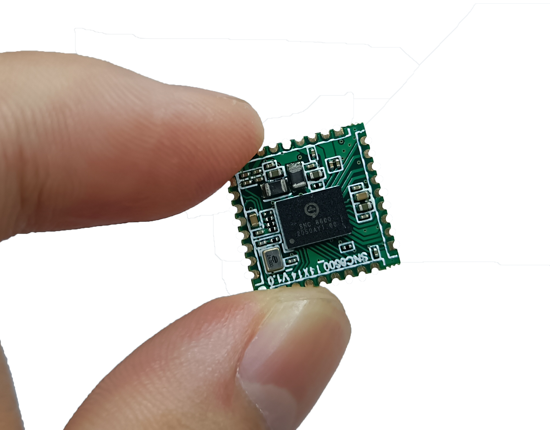
Module — BMT02
BMT02-14x14
BMT02 is a voice front-end solution module that supports up to 4 PDM digital microphone inputs.
It also supports 1 stereo analog differential input, 1 stereo analog differential output, 1 full duplex I2S, 1 I2C, 1 Uart, and 1 USB.
Main application scenarios:
Conference box, IoT, Wireless microphone, USB microphone, etc.
Size: 14x14 (mm).

Slide 11
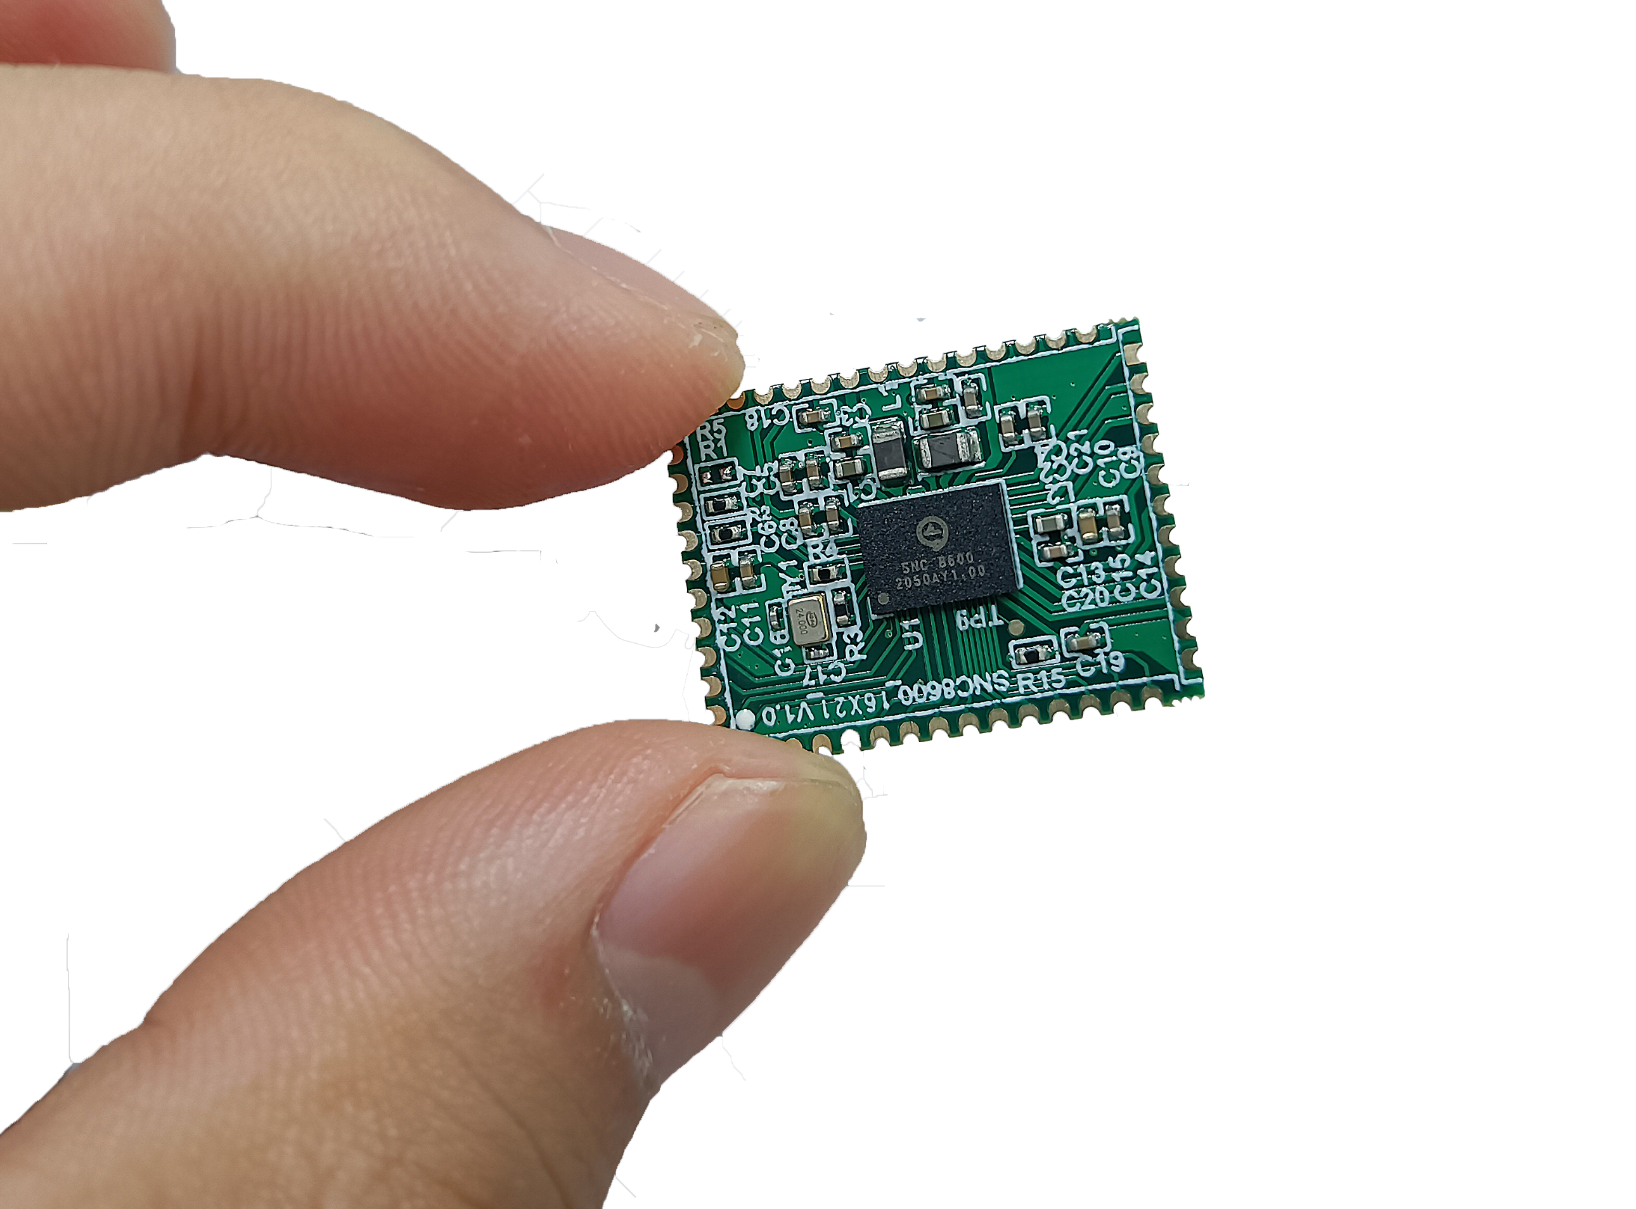
Module — BMT03
BMT03-26x21
BMT03 is a voice front-end solution module that supports up to 6 PDM digital microphone inputs.
It also supports 1 group of stereo analog differential input, 1 group of stereo analog differential output, 3 groups of full duplex I2S, 2 I2C, 1 Uart, and 1 USB.
Main application scenarios:
Conference Box, Speakers, IoT, USB microphone, etc.
Size: 26x21 (mm).

Slide 12
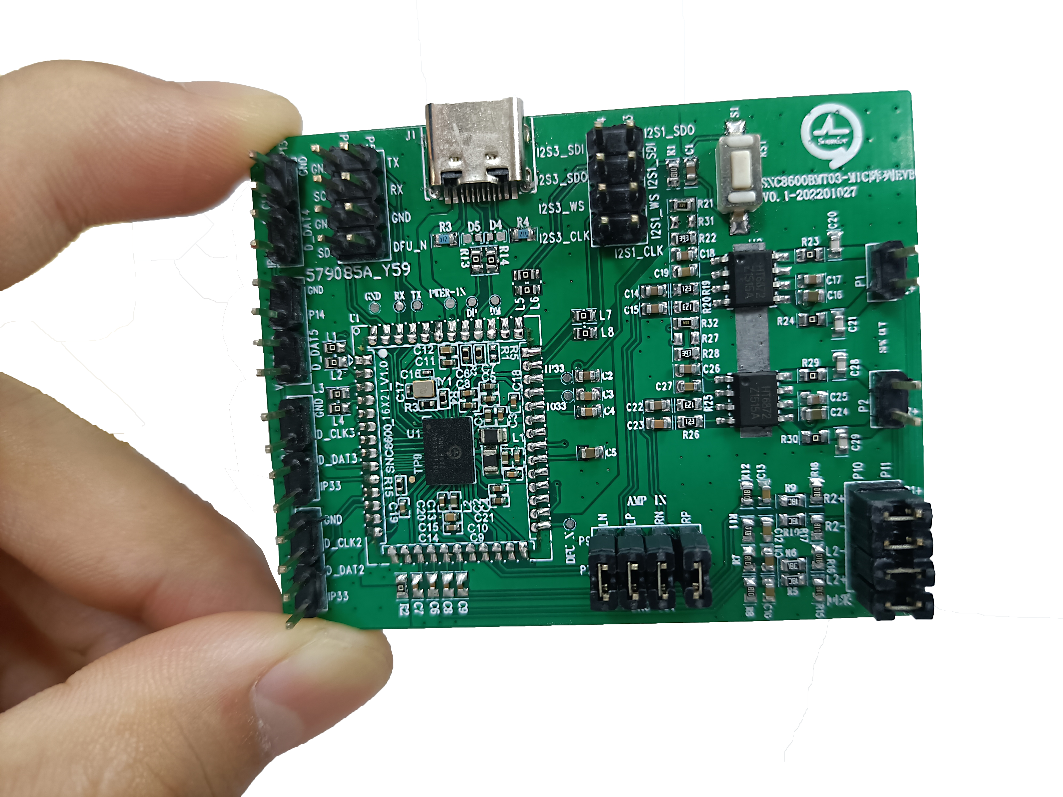
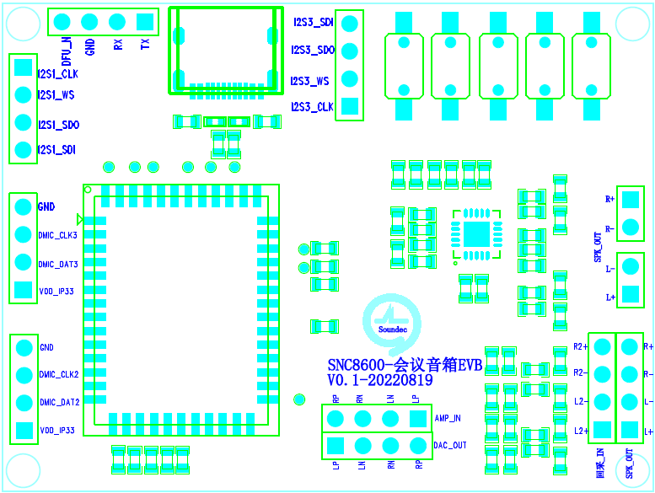
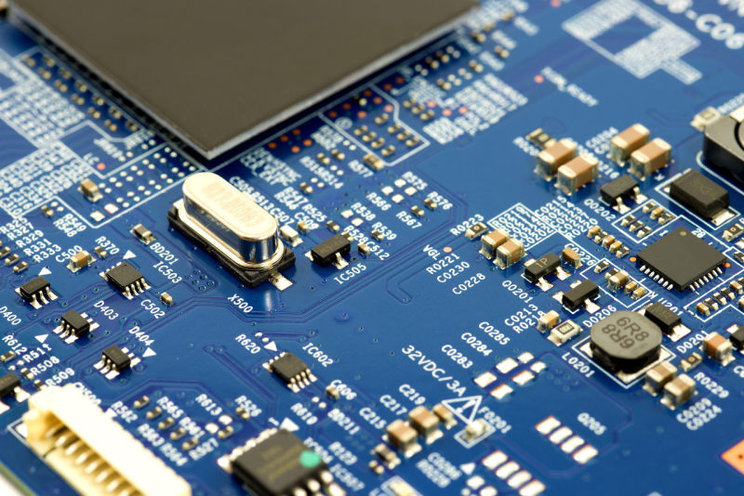

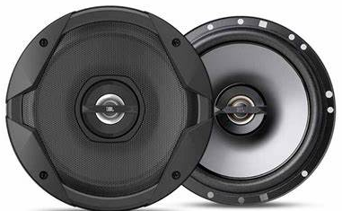
Module — BMT03 Mic Array
BMT03-MicArrayEVB
BMT03-MicrArrayEVB is a dedicated front-end voice signal processing module that supports microphone array.
This module supports analog input, analog output, 4 digital PDM microphone inputs, 2 sets of full-duplex I2S output, 1 USB which support UAC1.0 or UAC2.0.
Combined with the speech algorithm, the following functions can be achieved:
Beamforming, Sound Source Location, Voice wake up, Voice enhancement, Echo Cancellation, Noise Reduction, etc.
Main application scenarios:
Smart home, car front end, conference box, IoT, etc.
USB for PCM data dump and record
I2S for audio data transfer with main controller
2.54mm
Main Controller
PC
Type-C
2.54mm
2.54mm
Speaker out
2.54mm
2/4Mic Array
Reference for AEC

Slide 13
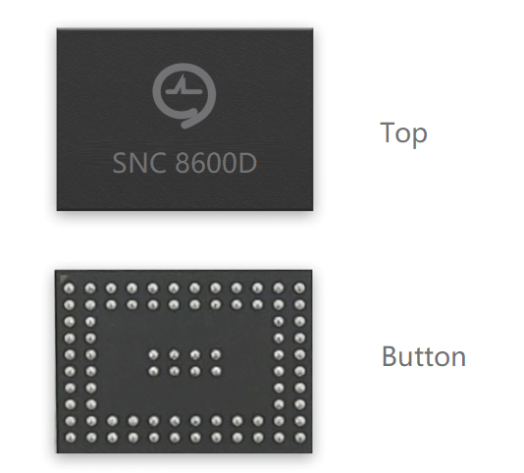
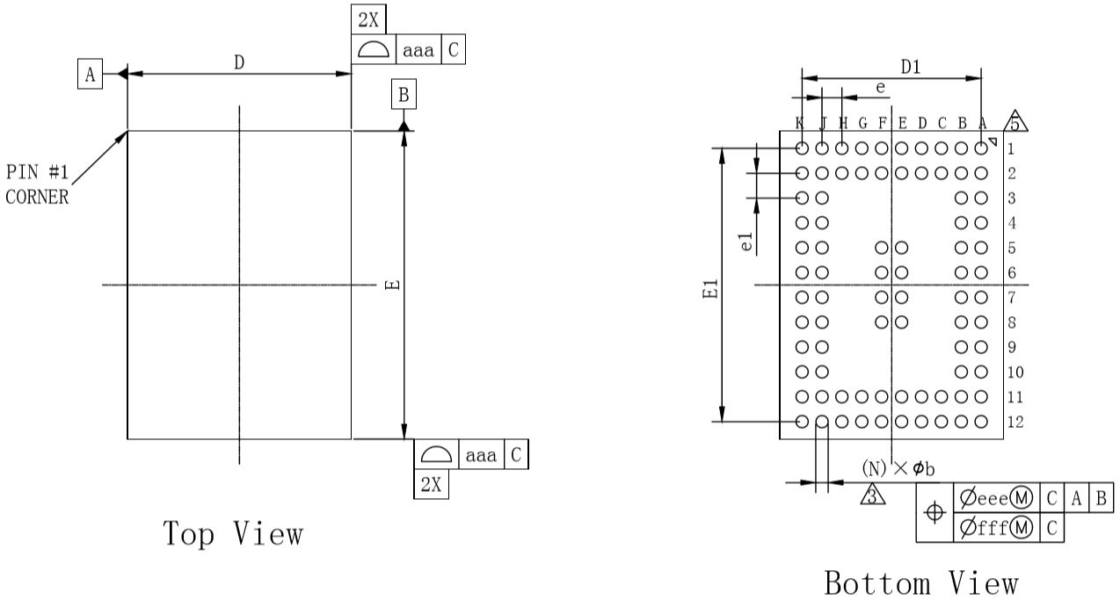
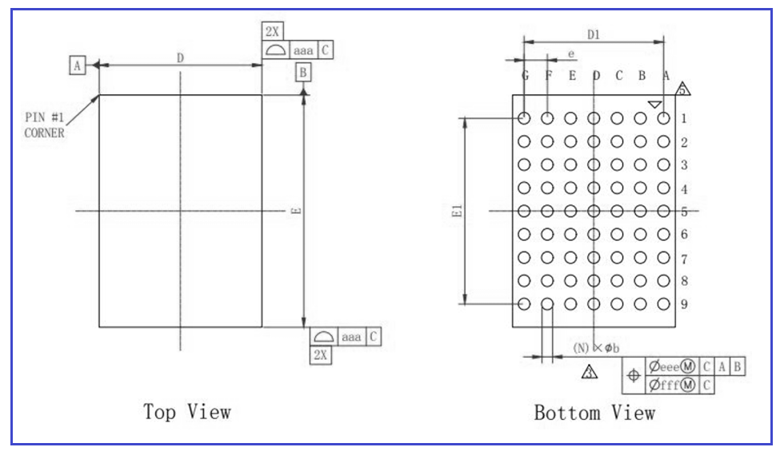
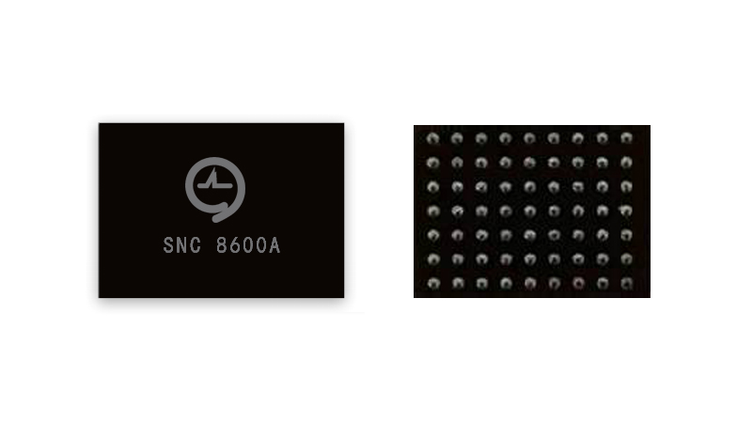
Packaging & Electrical performance
Packaging
Main electrical performance
SNC8600: BGA80
E: 6.2mm; D: 4.5mm; e: 0.4mm; e1: 0.5mm
Electrical performance
Power consumption(5V supply, 32Ω, 48KHz)
Powe consumption
I2S-DAC | <=12mA
USB-DAC | <=20mA
Latency
ADC-DAC | ＜3ms
ADC-USB | ＜10ms
ADC input Path(24bit,48KHz)
SNR | 106dB
Dynamic range | 106dB
THD+N | -88dB
DAC output Path (32Ω 24bit,48KHz GOM/GOD=0dB)
Output Power | 30mW
SNR | 101dB
Dynamic range | 110dB
THD+N | -81dB
Noise level | ＜5uVrms
SNC8600A: BGA63
E: 3.5mm; D: 4.5mm; e: 0.5mm; e1: 0.5mm
Notes:
P7 SNC 8600 芯片技术概要 （续）
- 功耗：不同应用下功耗差异
- 封装方式
- 其他重要信息
2023-2-10：
是否分应用列出功耗（参考ADI），硬件设计相关的主要参数：功耗、snr

Slide 14
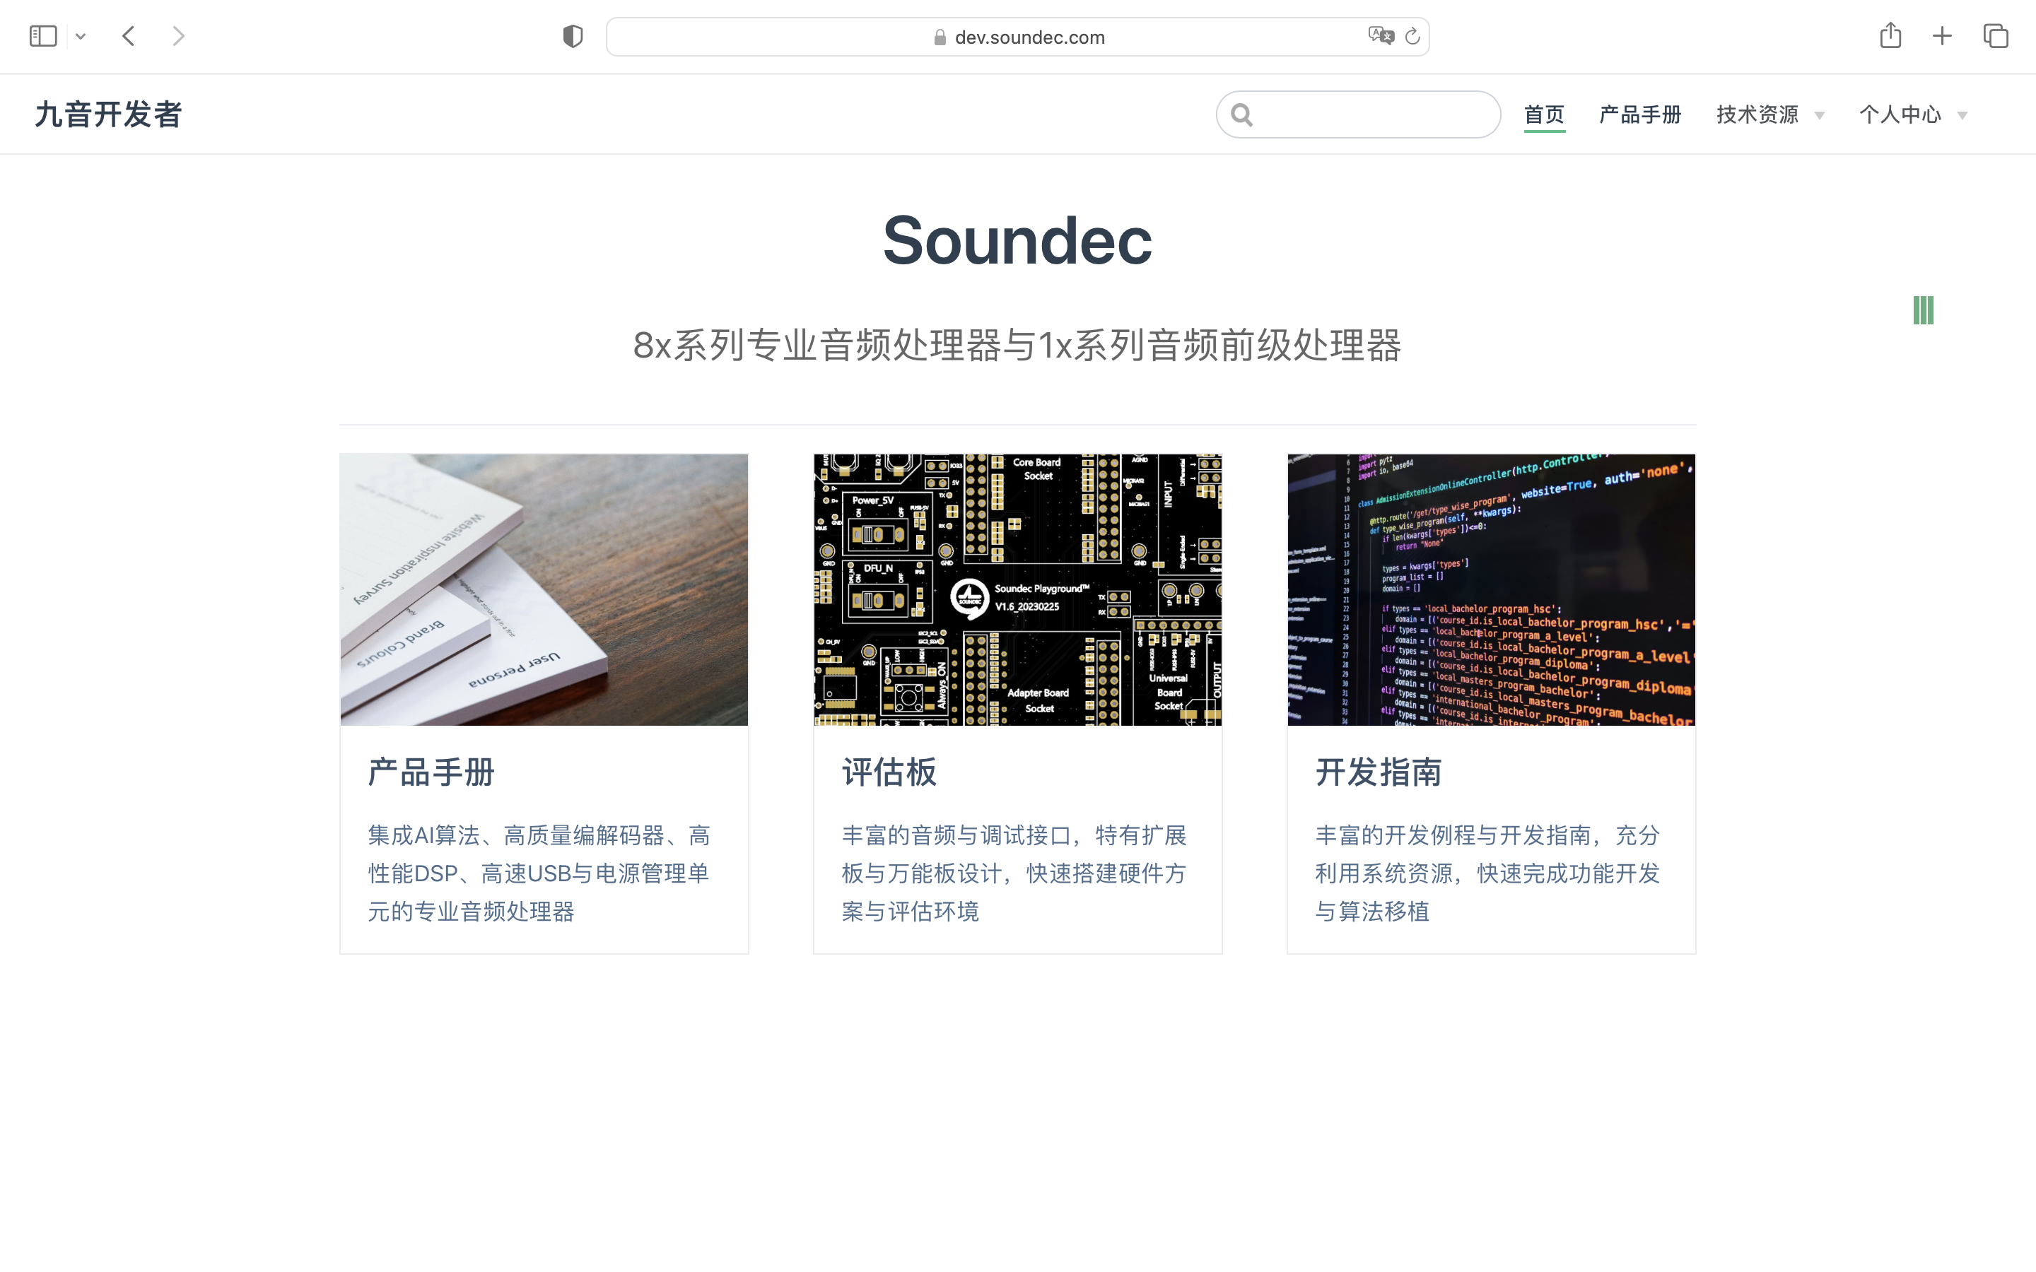
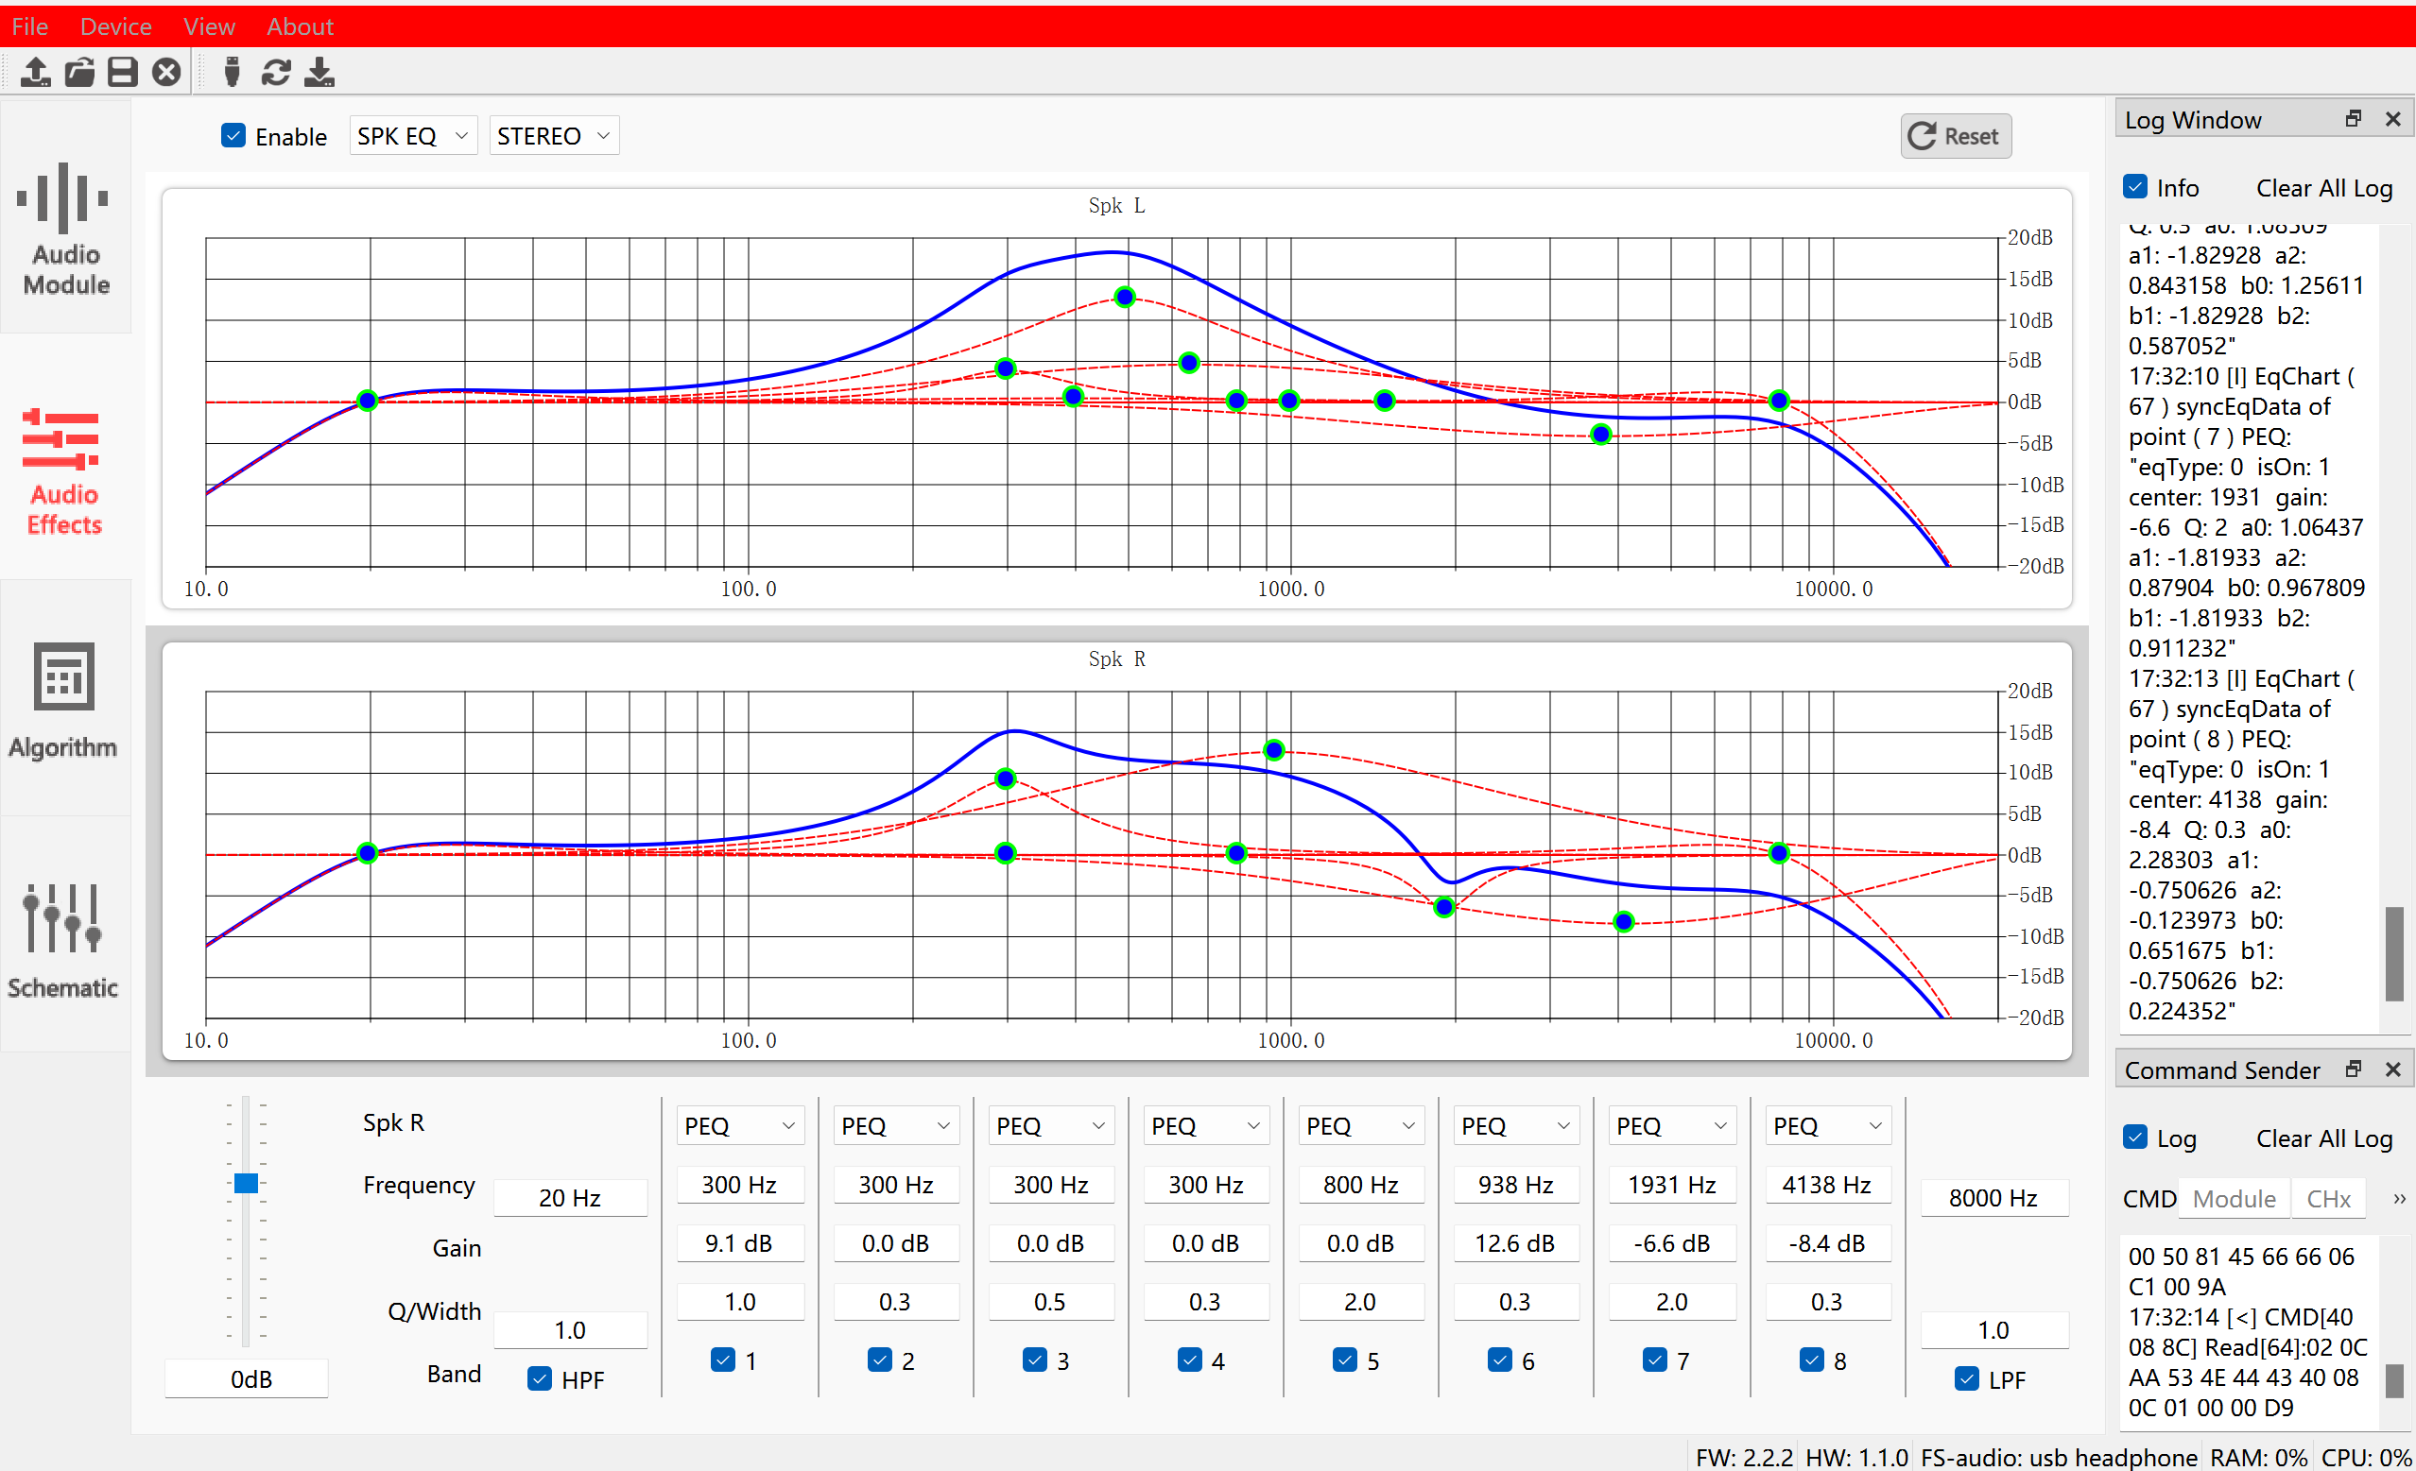
Developer ecosystem
Product manuals and evaluation board guidelines which support full-text search.
Rich development manuals for quickly get started.
Soundec Studio™ debugging tool support online parameter tuning.
Online work order system, 8 hours response.
For more information, please visit https://dev.soundec.com

Slide 15
Thank you！
Shenzhen Soundec Technology Co., Ltd

